Slide 1


Emirates Case Study
Marco Massetti

Slide 2
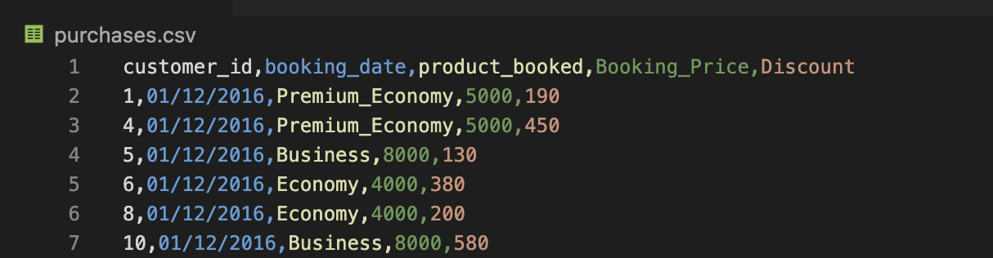
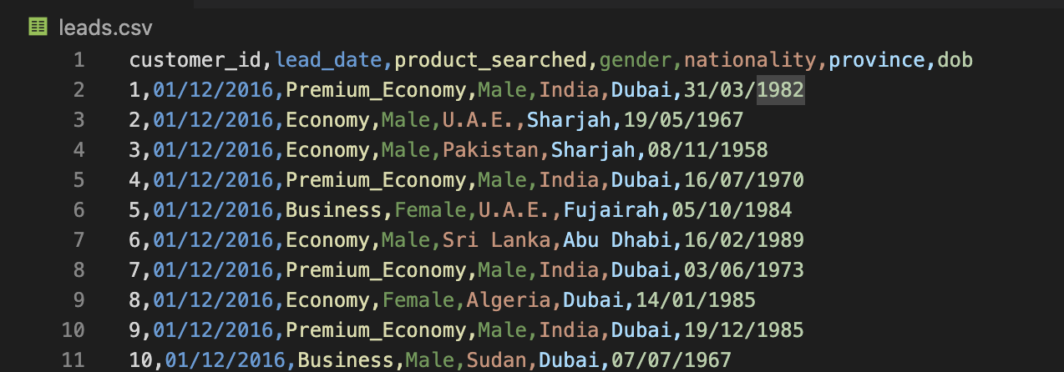
Scenario
Emirates Airline is a global carrier operating out of the UAE. The Airline sells three different seat types/products:
Economy Class
Average Retail price: 4,000 AED
Operations Cost: 2,000 AED
Premium Economy Class
Average Retail price: 5,000 AED
Cost: 2,500 AED
Business Class
Retail price: 8,000 AED (increased to 9,000 AED from January 2019)
Cost: 4,000 AED
Over the last three years, the company has seen a drop in sales and subsequently profit. To help combat the change, the company trialled two initiatives:
From January 2018, the Airline decided to up the maximum potential discounts from 10% to 20%
From January 2019, the Airline decided to increase the price of the Business Class seats from 8,000 to 9,000
It is unclear what impact each of these changes had on business performance.
You have been provided with two sets of data:
Leads (leads.csv) - A list of enquiries and associated customer information
Purchases (purchases.csv) - A list of purchases and their associated retail price and discount amount

Slide 3
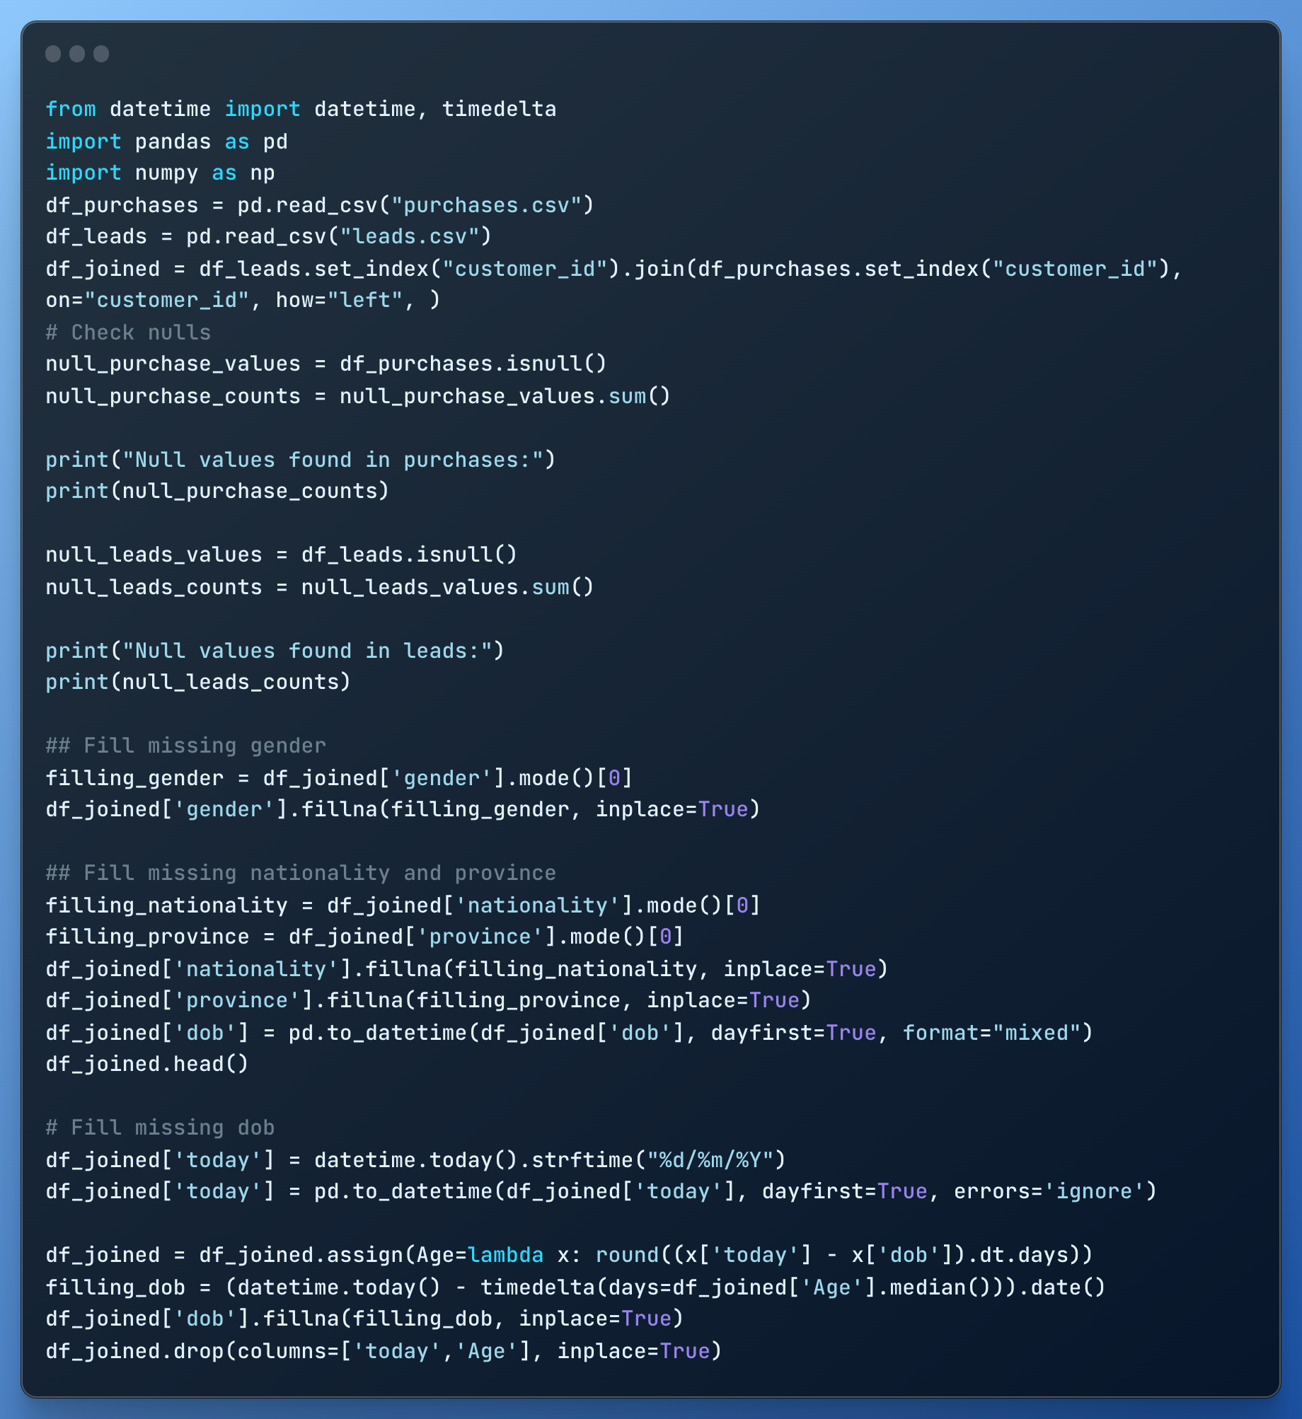
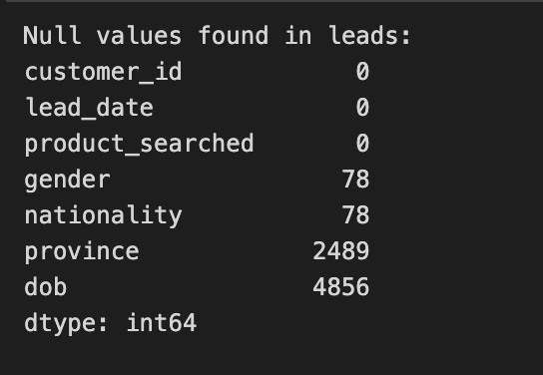
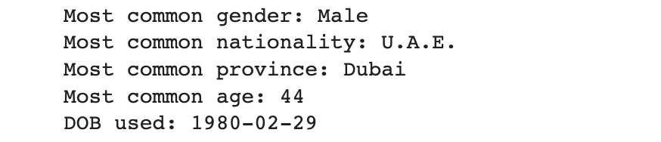
Data Cleaning
In Python, an easy way to handle CSV is through Pandas.
Pandas has a lot of methods that can be applied to a Dataframe
(the logical version of the CSV or a table).
In our case, a combination of isnull() and a sum of the results
will give us the total number of missing values per column.
To backfill the null data some ad-hoc logic must be applied:
Gender: Inferred from the mode or can be decided by the name*
Nationality & Province: Inferred from the mode. Maybe can be fixed with the information in the ticket*
DOB: Use a synthetic date from the median of the customer ages (*refer to a wider datasets)

Slide 4
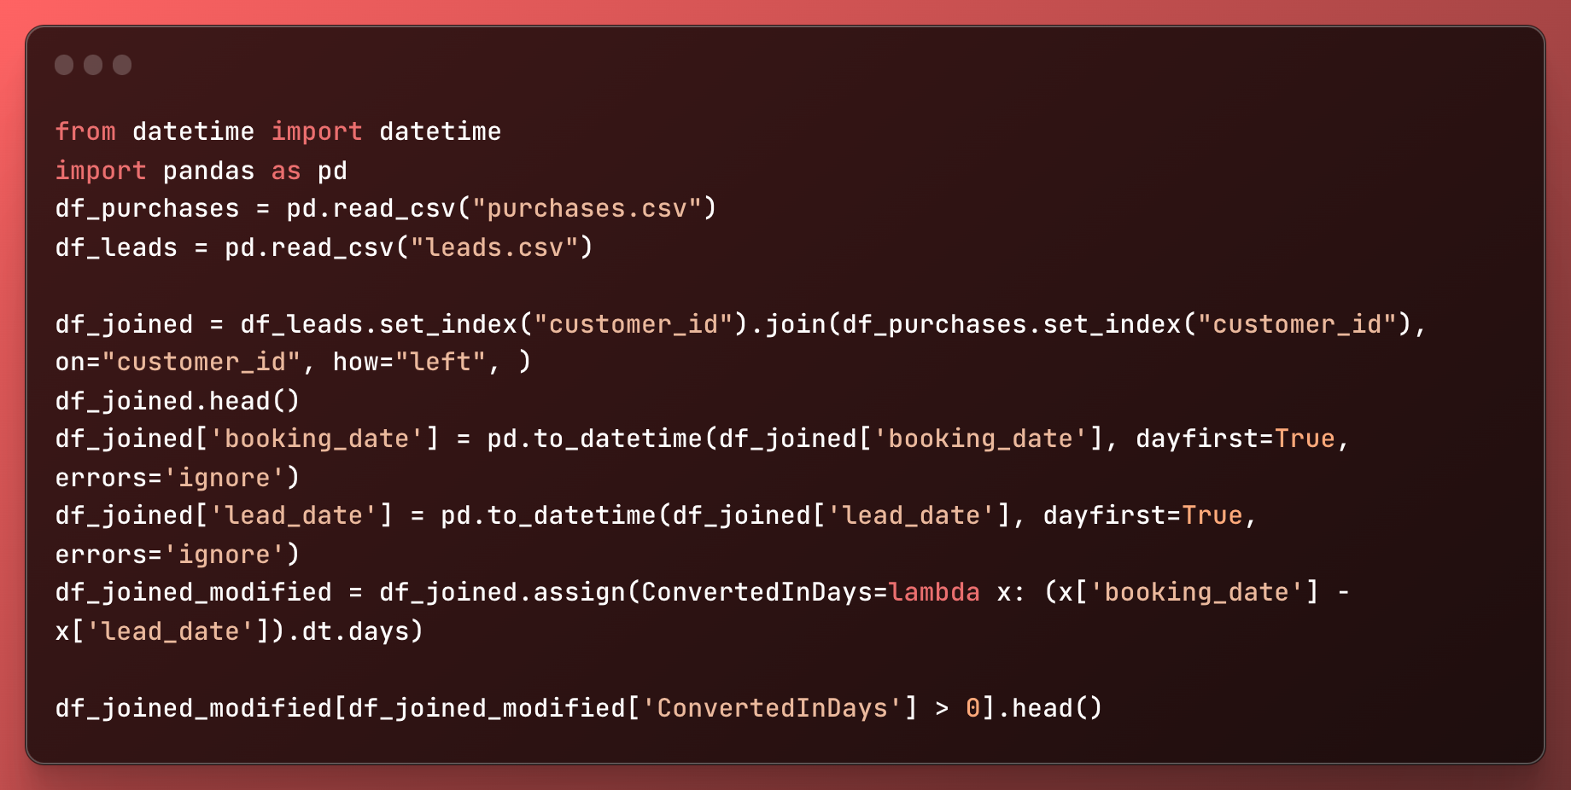
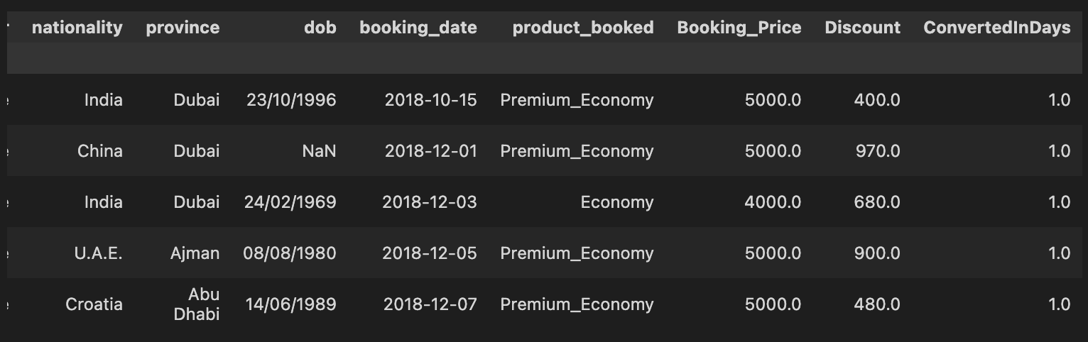
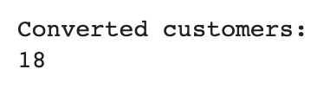
Data Manipulation
Add a new column in the dataset that represent the duration between a lead to convert into a purchase.
The approach is to calculate the
difference between the booking date
and the lead date.

Slide 5
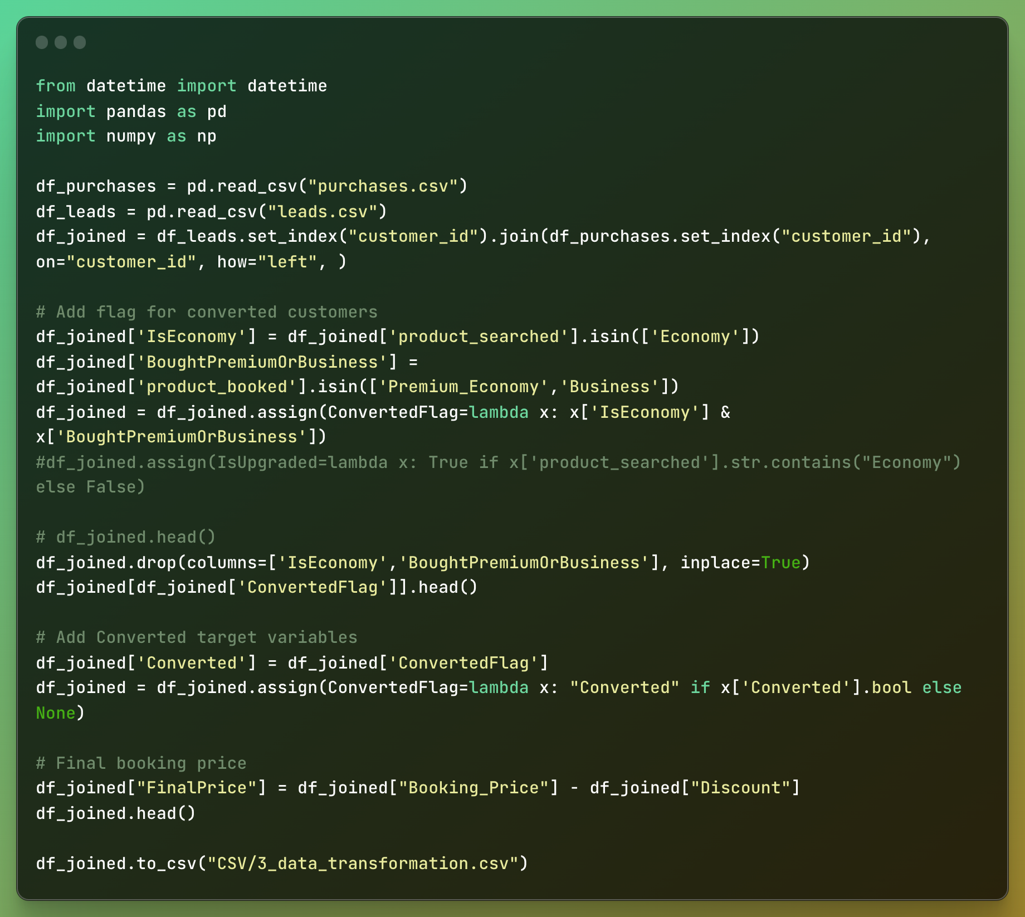
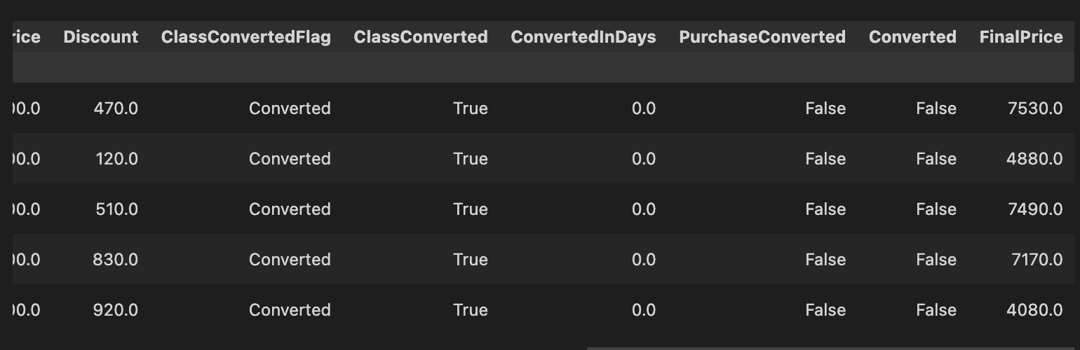
Data Transformation
Create a flag for customers who searched for Economy Class but ended up booking premium economy or business class ticket (comparing searched and booked)
Create a target variable called “Converted” for the analytics team
Calculate the final booking price after applying the discount for each customer who booked a flight

Slide 6
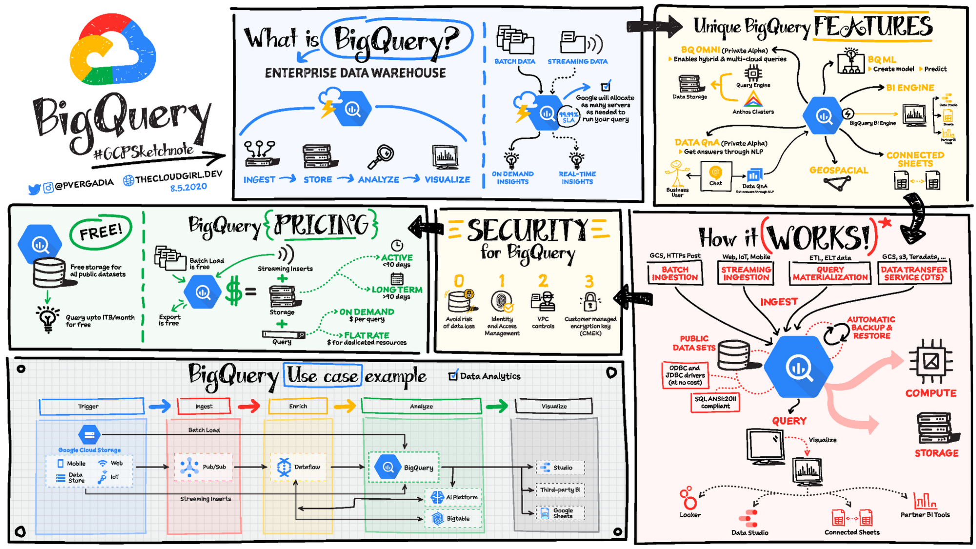
Data Storage
The best choice we have in GCP is BigQuery for analysis and querying of the data shown before. Scalability, speed, serveless are just few of the perks that the service can offer: integrated
with the Google Cloud Ecosystem,
Data Warehousing capabilities,
ML integration, Data Federation
and security.

Slide 7
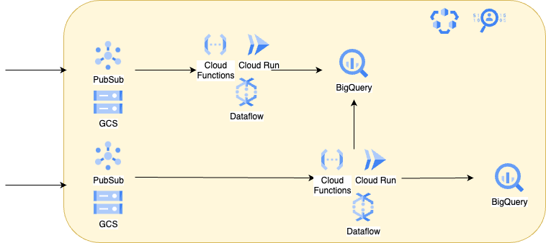
Data Pipeline
Leads
Purchases
Reliability: Forced BigQuery schema and/or relying on Data Catalog to ensure data quality
Scalability: BigQuery is transparent regarding increasing size or schema, while data processing services can be scaled up as needed

Slide 8
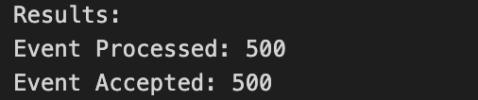
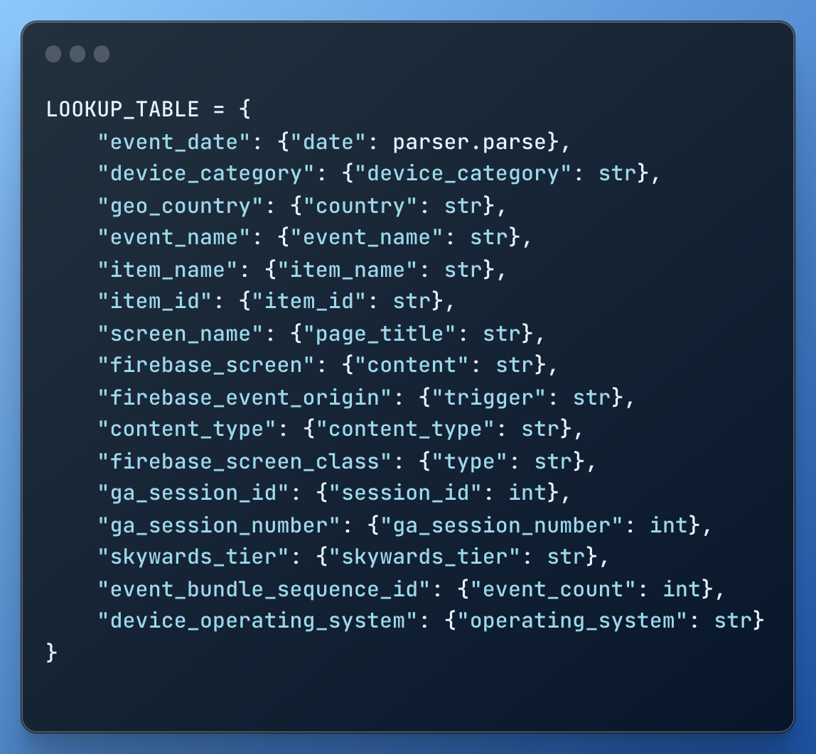
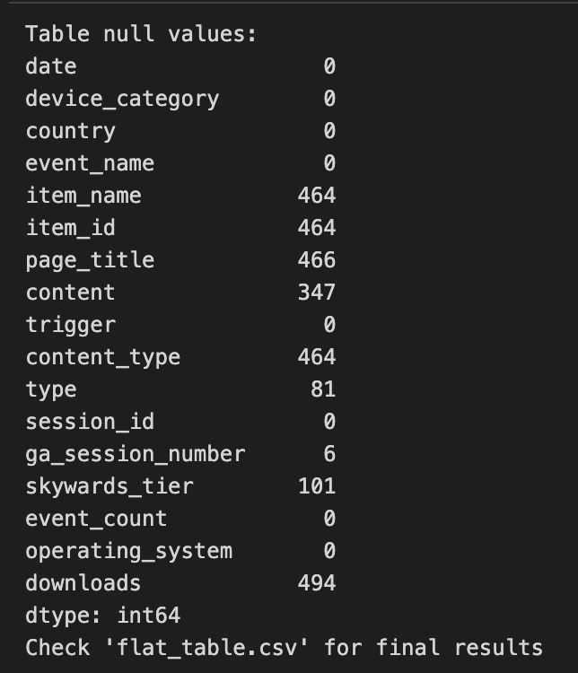
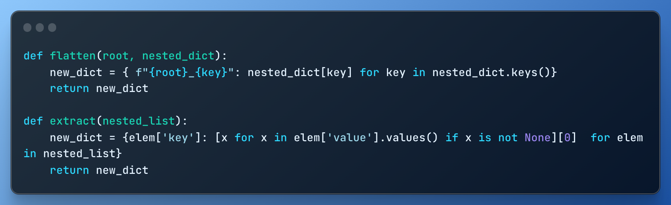
Extra: Raw Json Event Transformation

